Slide 1
Team Pi
Francis Ani
Ryan Hunt
Shannon Fox
Tim Griesemer
*Special recognition to our new Ubuntu machines
Notes:
First speaker slides 1-4

Slide 2
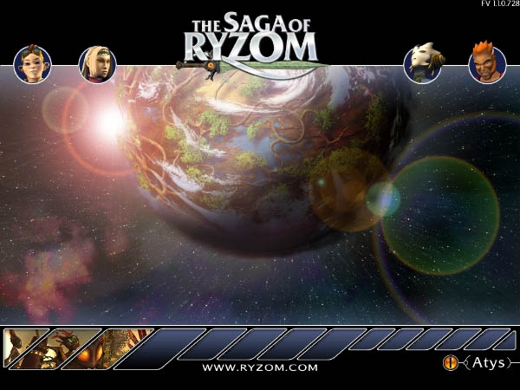
In the beginning there was….

Slide 3


Actually it was Nel—an awesome 3D framework
designed for video games
Their crowning achievement is Ryzom
We were overwhelmed at first—yet trudged along
Dealt with awful instructions & massive interface
Eventually determined that we did not have the tools
or skills to test this intense framework

Slide 4

What is HomeBank?
Open-source personal banking tool
Seamlessly work with transactions within
different accounts (such as checking, savings)
Import or add payees and spending categories
Create and manage personal budgets
Generate reports w/income, expenses, payees, etc...

Slide 5
Beginning the testing phase
HomeBank is written in C
Can be run in Linux/Mac or Windows
Is a GUI and won’t operate at the command line
We tested the various buttons, menus and textboxes
using a combination of 2 scripting languages:
      Xautomation
      Bourne bash shell script (.sh)
Notes:
Second speaker begins here—slides 5 thru 8

Slide 6
Some scripting commands:
mousemove X,Y – coordinates to place the mouse
mouseclick 1 – simulates the mouse click
key Return – simulates the return key
key Tab – simulates the tab key
“str nameOfString” – creates a string variable
usleep – forces the computer to wait—perhaps the
most important tool in our arsenal

Slide 7
How our tests operate:
Each test is individually performed by hand
Output is then saved into our oracle folder
Set of tests run automatically
      Output of these is saved into our temp folder
      Result is then compared ( diff )
      All subsequent tests follow this pattern
Once set is finished, output is displayed as html

Slide 8
Early sample testing script
#!/bin/bash
xte "usleep 20000" "mousemove 650 120" "usleep 20000" "mouseclick 1"
xte "usleep 20000" "mousemove 650 140" "usleep 20000" "mouseclick 1"
xte "usleep 20000" "str exampleWallet"
xte "usleep 20000" "mousemove 1100 520" "mouseclick 1"
xte "usleep 20000" "mouseclick 1"
xte "usleep 20000" "str account1" "usleep 20000" "key Tab" "usleep 20000" "key Tab"
xte "usleep 20000" "key Tab" "str 100.00" "usleep 20000" "mouseclick 1""usleep 20000" "mouseclick 1"
# saving file
xte "usleep 20000" "mousemove 650 120" "usleep 20000" "mouseclick 1"
xte "usleep 20000" "key Down" "usleep 20000" "key Down" "usleep 20000""key Down"
xte "usleep 20000" "key Down"
xte "usleep 20000" "key Return" "sleep 2" "str exampleFile2" "usleep 20000" "key Return"
# 'createNewFile.sh' finished
> ./createNewFile.sh

Slide 9
Early testing problems:
Discovered resolution differences causes mousemove
command to become unreliable
      Re-coded scripts to use hotkeys and other keys
      Increased the complexity of the code
      Discovery of a major flaw in their code
      (causing more complexity and aggravation)
Notes:
Third speaker starts here—slides 9-12

Slide 10
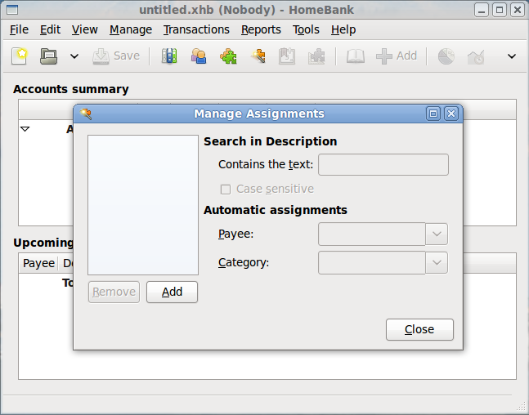

Slide 11
Next problem:
Inconsistent test results
      Unpredictable failures on host box
      Pass on some boxes and fail on others
Solution found by increasing sleep time
      Like Therac-25 operations occurring too fast
      Scripts re-coded to include LONG sleep times

Slide 12
Early Script Re-coded
#!/bin/bash
sleepTime="200000"
xte "usleep $sleepTime" "mousemove 26 38" "usleep $sleepTime" "mouseclick 1“ "key Down"
xte "usleep $sleepTime" "key Return" "usleep $sleepTime" "str exampleWallet"
xte "usleep $sleepTime" "keydown Alt_L" "usleep $sleepTime" "keydown f" "usleep $sleepTime"
xte "keyup Alt_L " "usleep $sleepTime" "keyup f" "usleep $sleepTime" "keydown Alt_L"
xte "usleep $sleepTime" "keydown f" "usleep $sleepTime" "keyup Alt_L " "usleep $sleepTime"
xte "keyup f" "usleep $sleepTime" "str account1" "usleep $sleepTime " "key Tab"
xte "usleep $sleepTime" "key Tab" "usleep $sleepTime" "key Tab" "str 100.00"
xte "usleep $sleepTime" "keydown Alt_L" "usleep $sleepTime" "keydown f" "usleep $sleepTime" xte "keyup Alt_L" "usleep $sleepTime" "keyup f" "usleep $sleepTime“ "keydown Alt_L"
xte "usleep $sleepTime" "keydown a" "usleep $sleepTime" "keyup Alt_L" "usleep $sleepTime"
xte "keyup a"
# 'createNewFile.sh' finished
> ./createNewFile.sh

Slide 13

Selected set of tests with out bugs:
Only half of our tests for demo—Long sleep times
Some of the things we’re testing in these:
      Create/delete assignments
      Delete payees/categories
      Change wallet owner’s name
Results will be presented in an html document
      All tests will pass
Notes:
Fourth speaker starts here—slides 13-17 (Temp = Pi_Testing_Clean
After this slide—transition to laptop—then back to slides after tests

Slide 14
Insertion of Bugs:
We chose 5 areas to attack
      Ability to change wallet owner’s name
      Ability to close an account
      Ability to add a new payee to the list
      Ability to delete a payee from the list
      Ability to delete a category from the list
Each bug was injected/tested on clean build
Notes:
While this & next slide is in progress, someone needs to change HomeBank temp folder to Pi_Testing_3_bugs

Slide 15

Selected set of tests with bugs:
Same tests as before except four tests will fail
These tests will fail because:
      20 & 21 due to problems deleting categories
      22 due to problems deleting payees
      28 due to problems renaming wallet owner
Results will be presented in an html document
Notes:
After this slide transition to laptop for tests—then back here again for closing

Slide 16
In Closing:
Overcame being overwhelmed
Forced to familiarize ourselves with Linux
Gained experience with a scripting language
Learned to cooperate in a prof. team environment
New experience...injecting bugs

Slide 17

Questions/Comments?

